Slide 1
Club Night 12/11/2018

Slide 2
Facebook updates (last 28 days)
Derbyshire Advanced Motorcyclists
Facebook page
Facebook group (members only)
Metrix | Score | ▲/▼
Page views | 25 | ▼65%
Page likes | - | %
Reach | 81 | ▼17%
Post engagement | 65 | ▼88%
Page followers | 1 | ▼67%
Metrix | Score | ▲/▼
Members | 85* | ▲1%
New members | 1 | ▼75%
Posts | 21 | ▼46%
Comments | 106 | ▼51%
Reactions | 162 | ▼50%
*75 Active members
Notes:
Page views – Number of times the page has been viewed
Page likes – The number of new people registering a like
Reach - The number of people who had any posts from your Page enter their screen
Post engagements – The number of times people have engaged with our posts through likes, comments, shares
Page followers – The number of people who have followed the page
Members – The total number of members in the group
New members – New members to the group
Posts – The number of new posts in the group
Comments – The number of comments in the group
Reactions – The number of reactions in the group
*Active members – Members who’ve viewed, posted commented on or reacted to group content

Slide 3
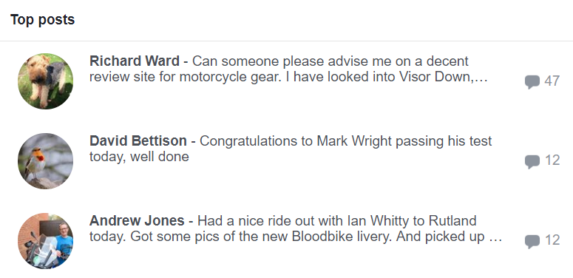
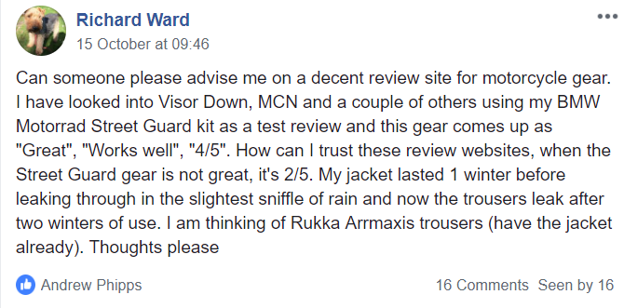
Facebook highlights (last 28 days)
Derbyshire Advanced Motorcyclists
Facebook group

Slide 4
Facebook highlights (last 28 days)
Derbyshire Advanced Motorcyclists
Facebook group

Slide 5
Twitter updates (last 28 days)
Derbyshire Advanced Motorcyclists
Notes:
Impressions – Number of times users saw the Tweet on Twitter
Engagements – Total number of times a user has interacted with a Tweet. This includes all clicks anywhere on the Tweet (including hashtags, links, avatar, username), retweets, replies follows and/or likes
Engagement rate – The number of engagements (clicks, retweets, replies, follows and likes) divided by the total number of impressions.

Slide 6
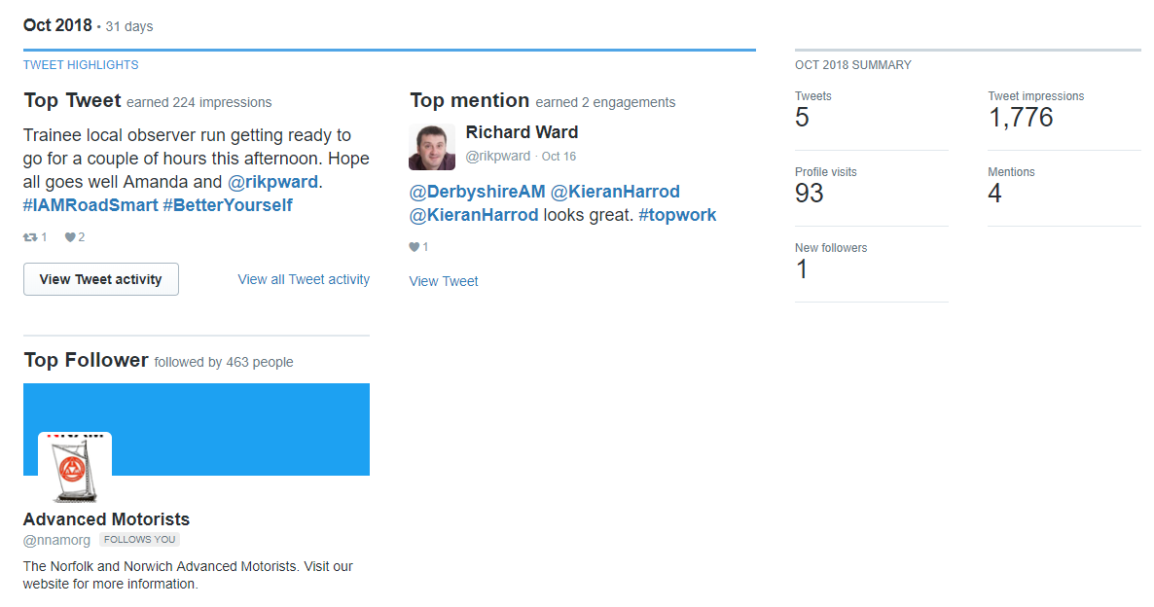
Twitter highlights (October 2018)
Derbyshire Advanced Motorcyclists

Slide 7
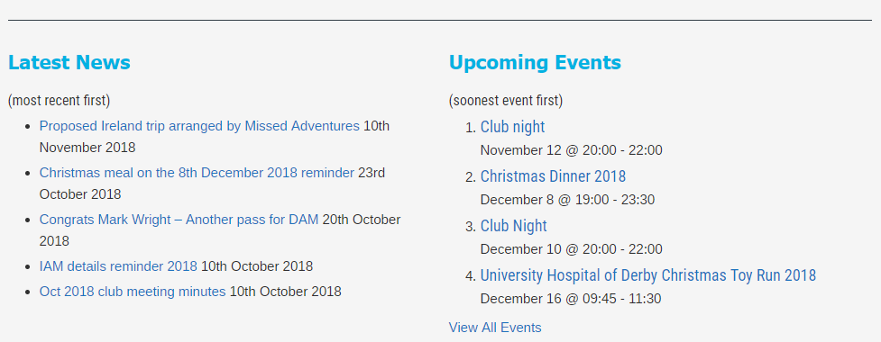
Club website - https://derbyam.org.uk/
Derbyshire Advanced Motorcyclists
Front (Home) page reshuffle - The five latest posts and five upcoming events are now more prominent.

