Slide 1


Club Night 14/01/2019

Slide 2


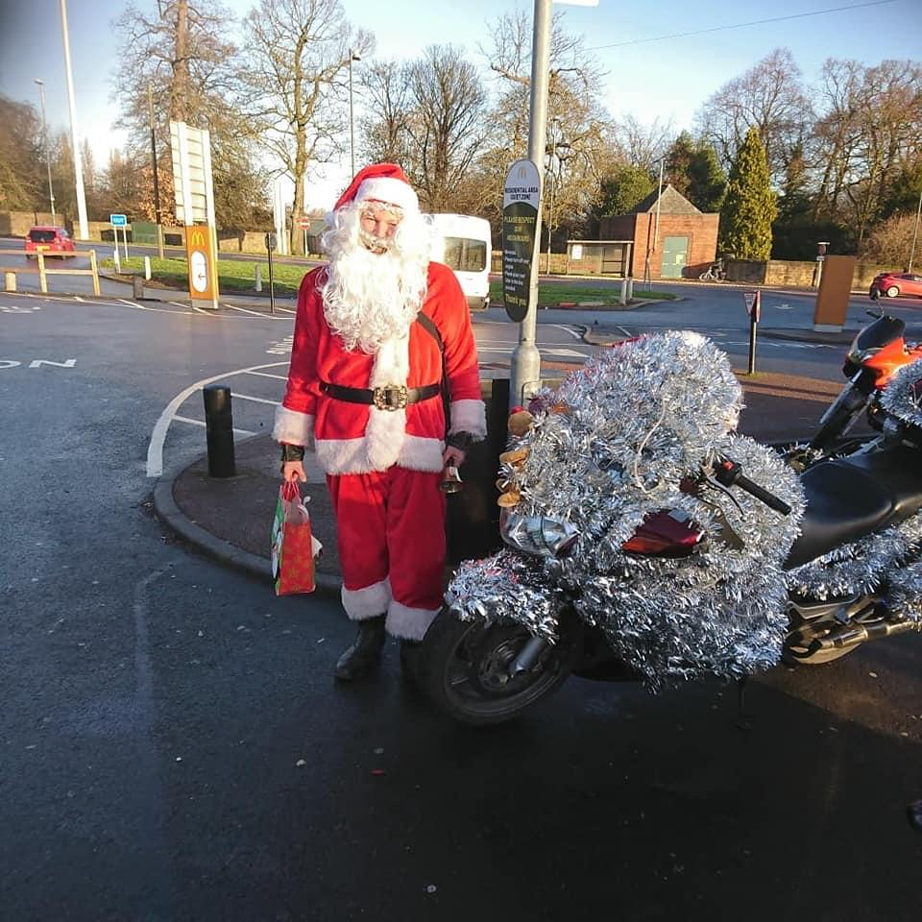
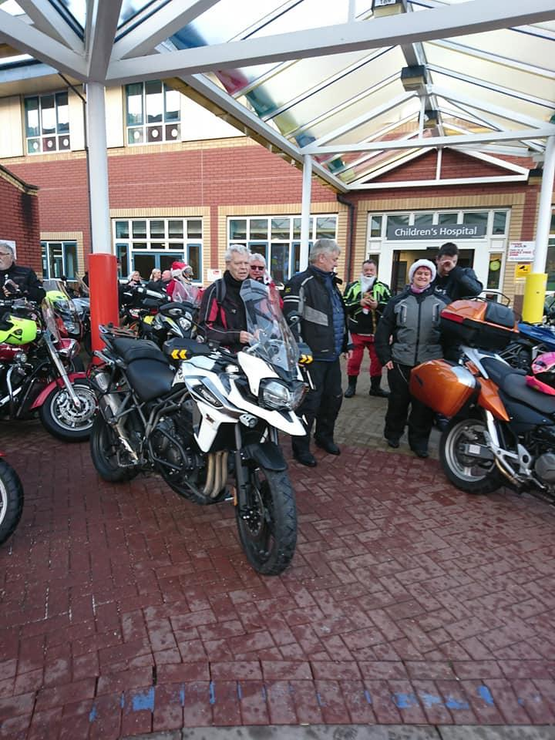

Facebook
Derbyshire Advanced Motorcyclists
Christmas toy run was a success.

Slide 3
Facebook updates (last 28 days)
Derbyshire Advanced Motorcyclists
Facebook page
Facebook group (members only)
Metrix | Score | ▲/▼
Page views | 32 | ▼77%
Page likes | 1 | ▼94%
Reach | 133 | ▼98%
Post engagement | 316 | ▼73%
Page followers | 2 | ▼88%
Metrix | Score | ▲/▼
Members | 88 | ▲▼-%
New members | 0 | ▲▼-%
Posts | 26 | ▼10%
Comments | 138 | ▼32%
Reactions | 257 | ▼27%
*81 Active members
Notes:
Page views – Number of times the page has been viewed
Page likes – The number of new people registering a like
Reach - The number of people who had any posts from your Page enter their screen
Post engagements – The number of times people have engaged with our posts through likes, comments, shares
Page followers – The number of people who have followed the page
Members – The total number of members in the group
New members – New members to the group
Posts – The number of new posts in the group
Comments – The number of comments in the group
Reactions – The number of reactions in the group
*Active members – Members who’ve viewed, posted commented on or reacted to group content

Slide 4
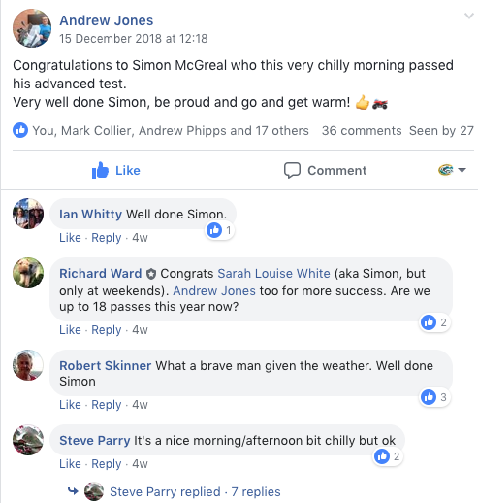
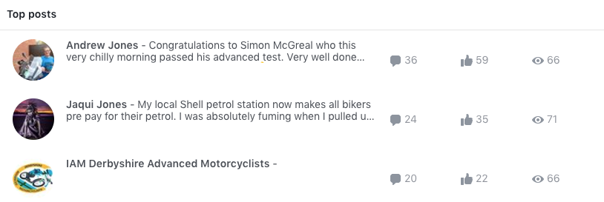
Facebook highlights (last 28 days)
Derbyshire Advanced Motorcyclists
Facebook group

Slide 5

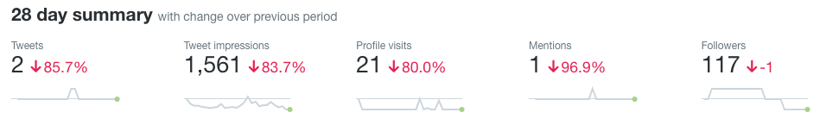
Twitter updates (last 28 days)
Derbyshire Advanced Motorcyclists
Notes:
Impressions – Number of times users saw the Tweet on Twitter
Engagements – Total number of times a user has interacted with a Tweet. This includes all clicks anywhere on the Tweet (including hashtags, links, avatar, username), retweets, replies follows and/or likes
Engagement rate – The number of engagements (clicks, retweets, replies, follows and likes) divided by the total number of impressions.

Slide 6
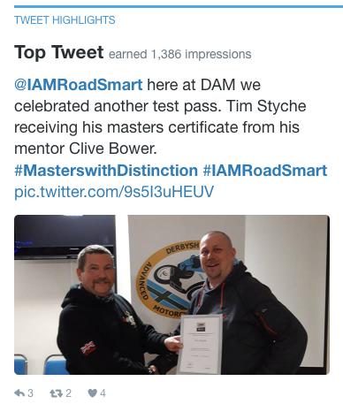
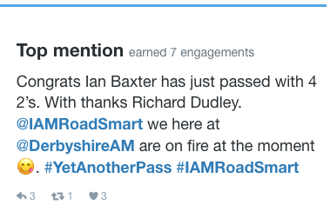
Twitter highlights (December 2018)
Derbyshire Advanced Motorcyclists

Slide 7
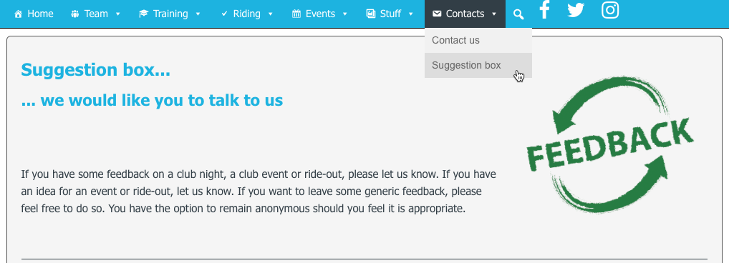
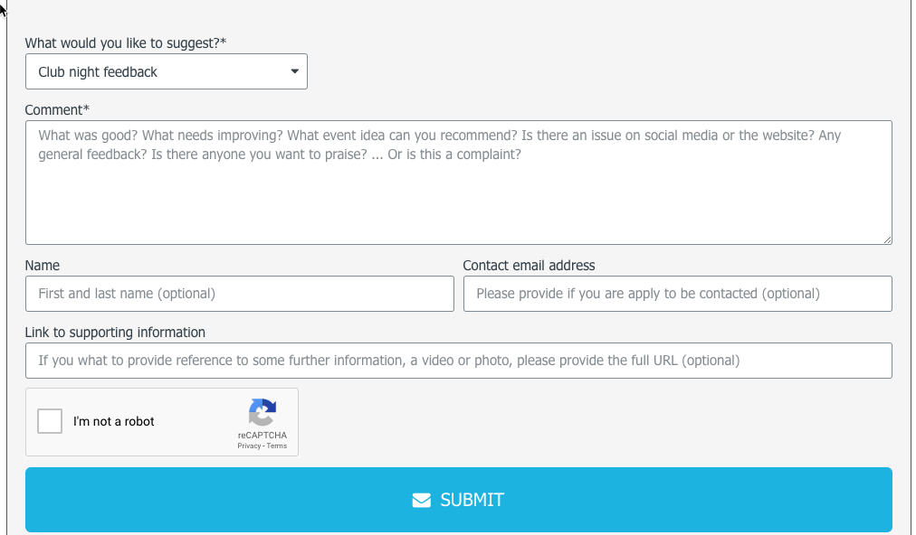
Club website - https://derbyam.org.uk/
Derbyshire Advanced Motorcyclists
Feedback form

