Slide 1
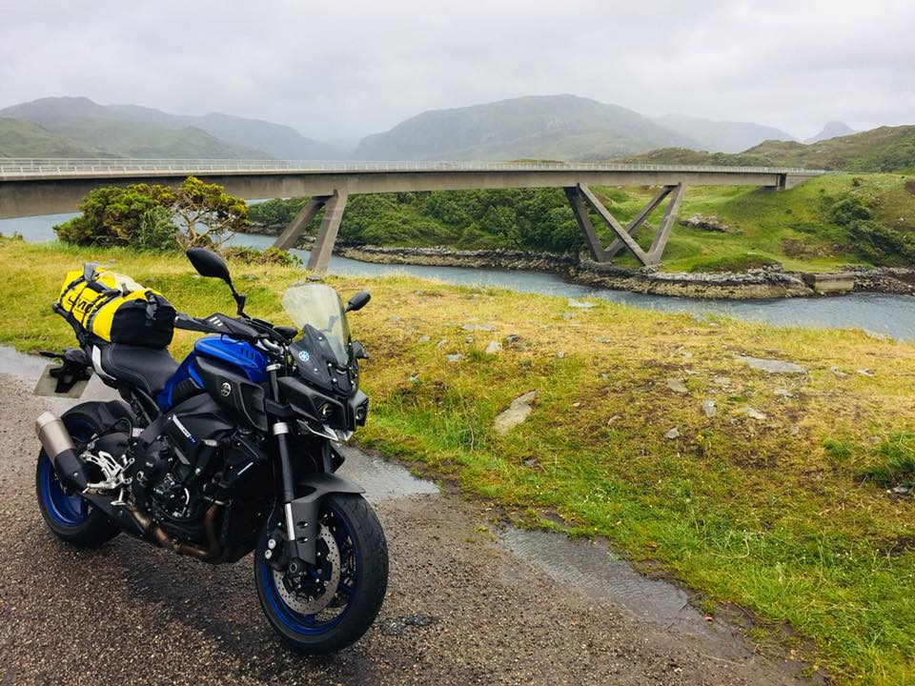
Derbyshire Advanced Motorcyclists
Club Night 13/08/2018

Slide 2
The new(ish) Facebook Page
Derbyshire Advanced Motorcyclists
To improve the social footprint of DAM, more than a closed Facebook group was necessary. Benefits include:
Public front
Improved control over events
Post as DAM and not an individual
Analytics
The page is found at https://www.facebook.com/DerbyshireAM/

Slide 3
Facebook updates (last 28 days)
Derbyshire Advanced Motorcyclists
Facebook page
Facebook group
Metrix | Score | ▲/▼
Page views | 34 | ▼65%
Page likes | 1 | ▲4%
Reach | 27 | ▼4%
Post engagement | 7 | ▲17%
Page followers | 1 | ▲100%
Metrix | Score | ▲/▼
Members | 79* | ▲1%
New members | 3^ | ▲0%
Posts | 24 | ▼67%
Comments | 83 | ▼77%
Reactions | 124 | ▼74%
* 74 Active members
^ 2 Pending members
Notes:
Page views – Number of times the page has been viewed
Page likes – The number of new people registering a like
Reach - The number of people who had any posts from your Page enter their screen
Post engagements – The number of times people have engaged with our posts through likes, comments, shares
Page followers – The number of people who have followed the page
Members – The total number of members in the group
New members – New members to the group
Posts – The number of new posts in the group
Comments – The number of comments in the group
Reactions – The number of reactions in the group
*Active members – Members who’ve viewed, posted commented on or reacted to group content

Slide 4
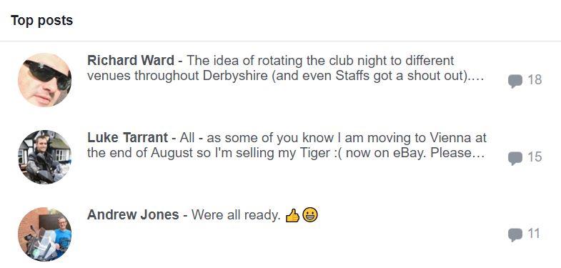
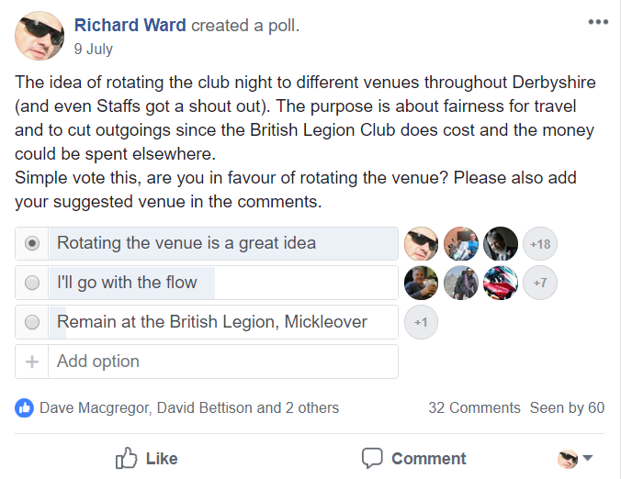
Facebook highlights (last 28 days)
Derbyshire Advanced Motorcyclists
Facebook group

Slide 5
Twitter updates (last 28 days)
Derbyshire Advanced Motorcyclists
Your Tweets earned 1,298 (▼30.4%) impressions over this 28 day period
Top Tweets | Impressions | Engagements | Engagement rate
Derbyshire AM @DerbyshireAM Jul 21Don't forget ladies @CMCbikes on the 5th August. @DerbyshireAM will be there offering taster sessions and looking at for new club members. #DAM #ladiesridebikestoo #cmcrocks #IAMRoadSmart | 140 | 1 | 0.7%
Derbyshire AM @DerbyshireAM Jul 24Edit item Not Guilty! disq.us/t/34p6oyo | 116 | 14 | 14.7%
Derbyshire AM @DerbyshireAM Aug 1Give a 'Thumbs Up!' this August to celebrate and encourage courtesy between drivers, riders and other road users. thndr.me/NIBjTn pic.twitter.com/Blu4MbJIhM | 115 | 1 | 0.9%
Notes:
Impressions – Number of times users saw the Tweet on Twitter
Engagements – Total number of times a user has interacted with a Tweet. This includes all clicks anywhere on the Tweet (including hashtags, links, avatar, username), retweets, replies follows and/or likes
Engagement rate – The number of engagements (clicks, retweets, replies, follows and likes) divided by the total number of impressions.

Slide 6
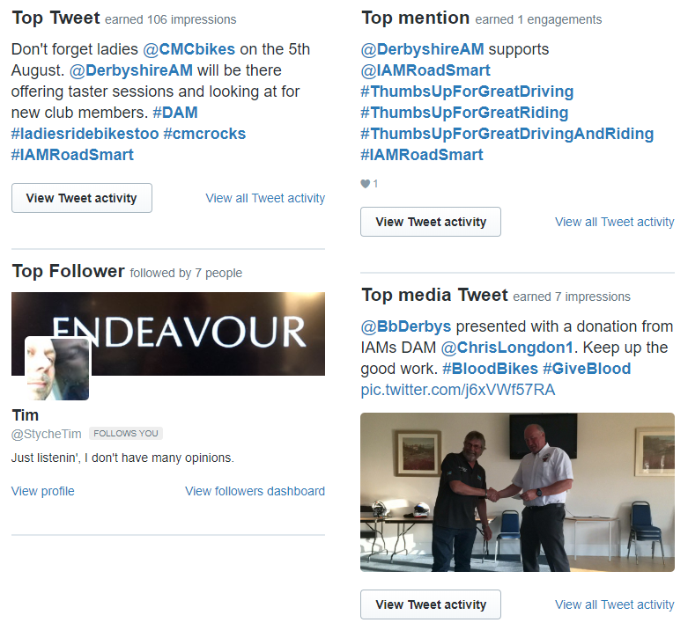
Twitter highlights (July 2018)
Derbyshire Advanced Motorcyclists

Slide 7
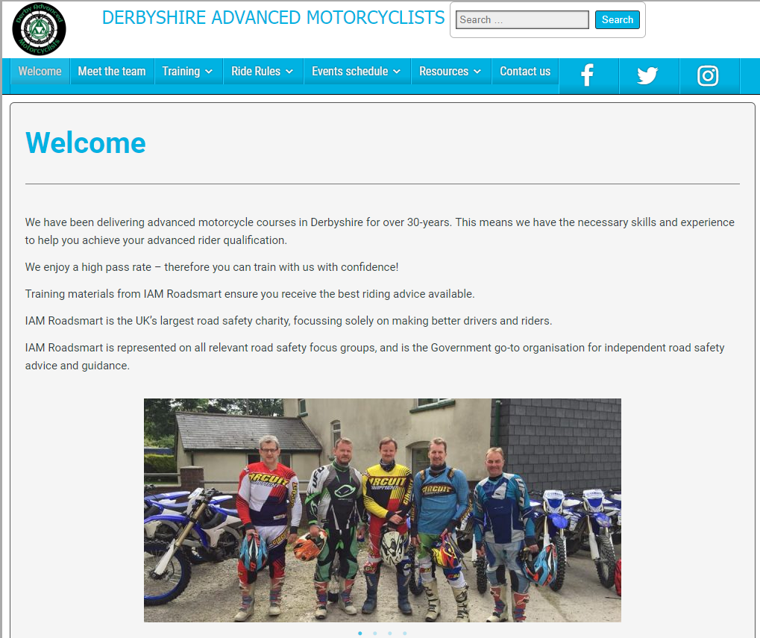
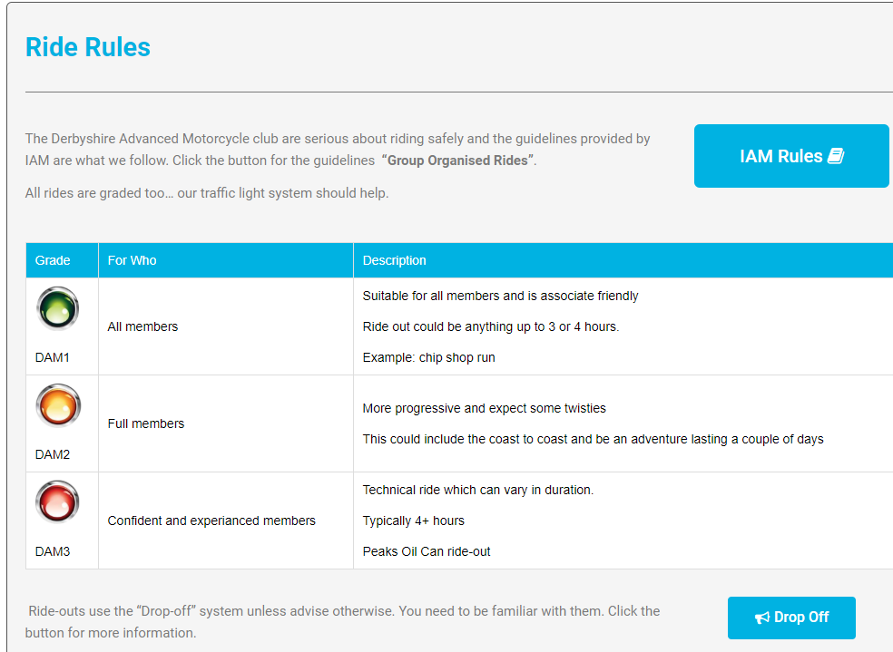
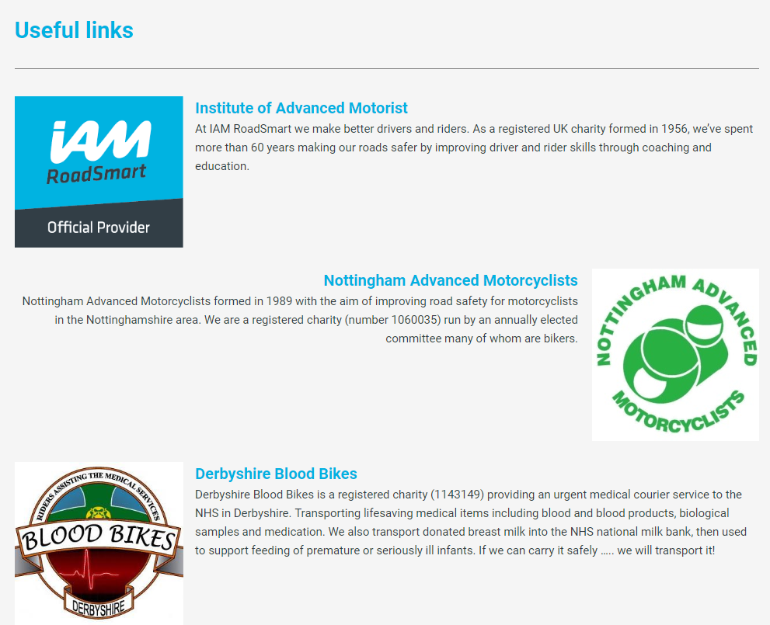
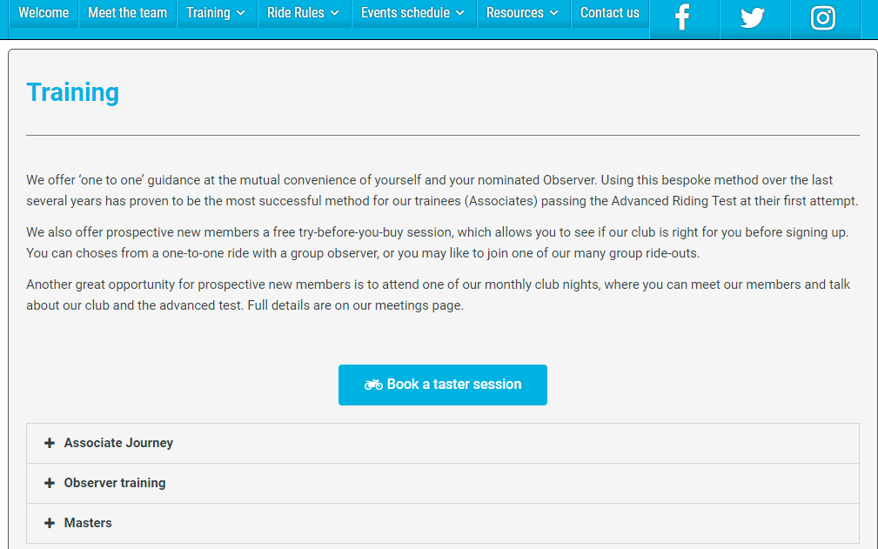
Club website - https://derbyam.org.uk/
Derbyshire Advanced Motorcyclists
Notes:
Old - http://derbyam.org.uk/
New - http://derbyam.org.uk/?page_id=1779&preview=true

Slide 8
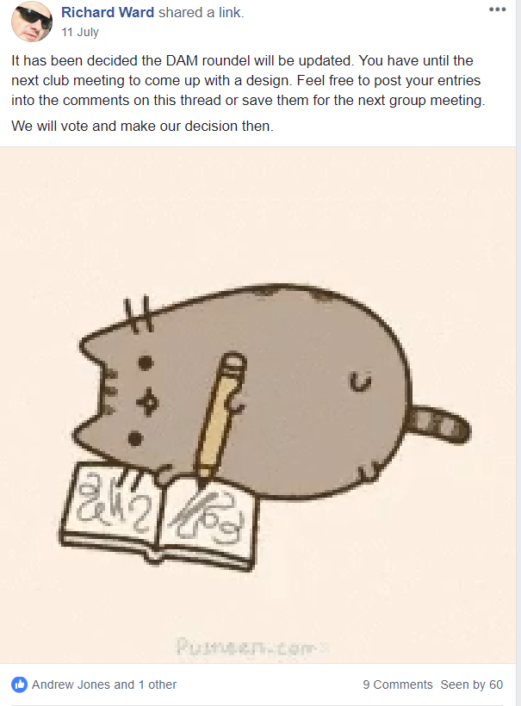
DAM branding
Derbyshire Advanced Motorcyclists
Facebook poll

